Slide 1

Social Network Analysis & Visualisation
#SHDB17
Ellen König, Syennie Valeria, Thomas Beutin

Slide 2
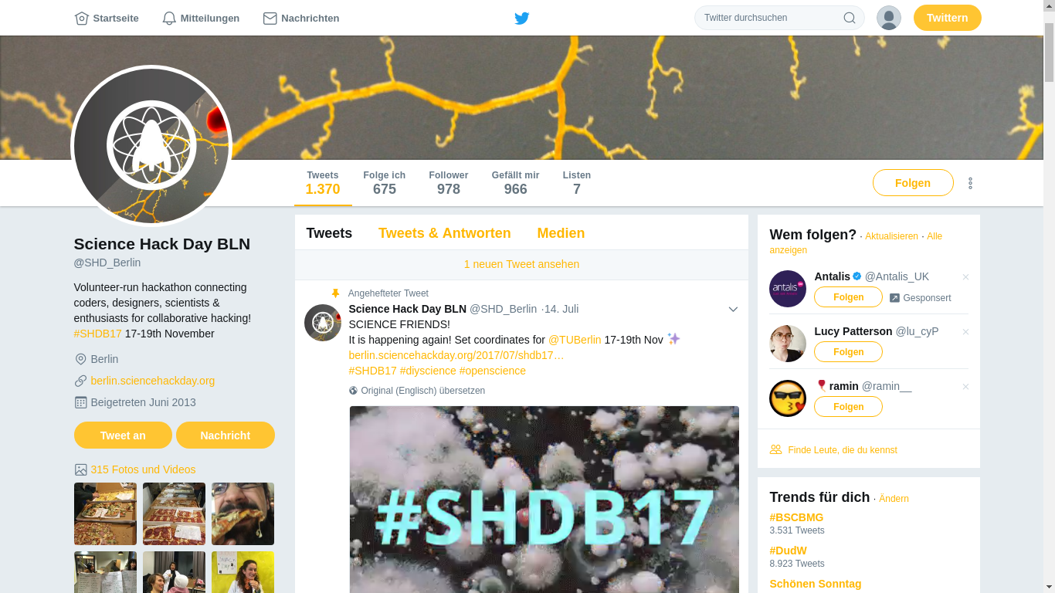

Slide 3
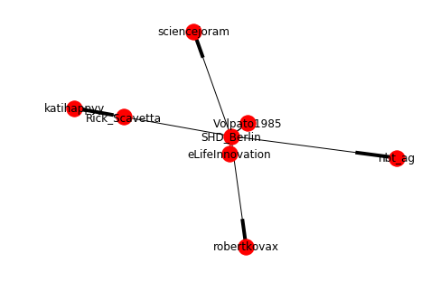
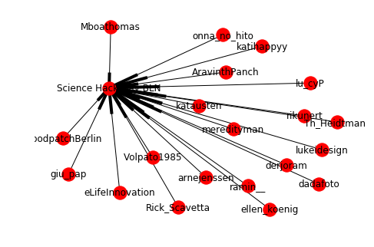
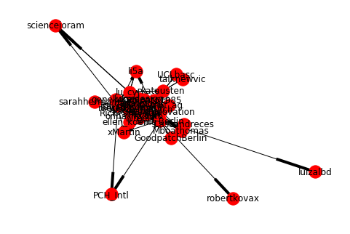

Slide 4
